Slide 1
Embedded System for Real-time Overhead Clearance and Collison Detection for Vehicles (Internet Programming Project)
Jane Doe and John Doe
Summer 2020
The University of Texas Rio Grande Valley

Slide 2
Project Overview
Overhead clearance detection in real-time using
Collision detection in real-time using
Central Management System (CMS)
Backend database storing data, such as motion, timestamp, overhead clearance, Collison detection, image
Website showing recent history
Profiling tools to display history

Slide 3
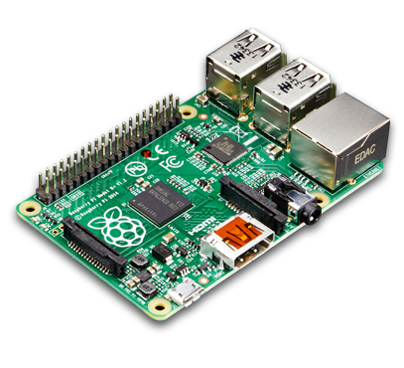
Raspberry Pi
Small hardened microcomputer system
GPIO Pins for interfacing actuators & sensors
Linux based OS
Wireless & wired connectivity

Slide 4


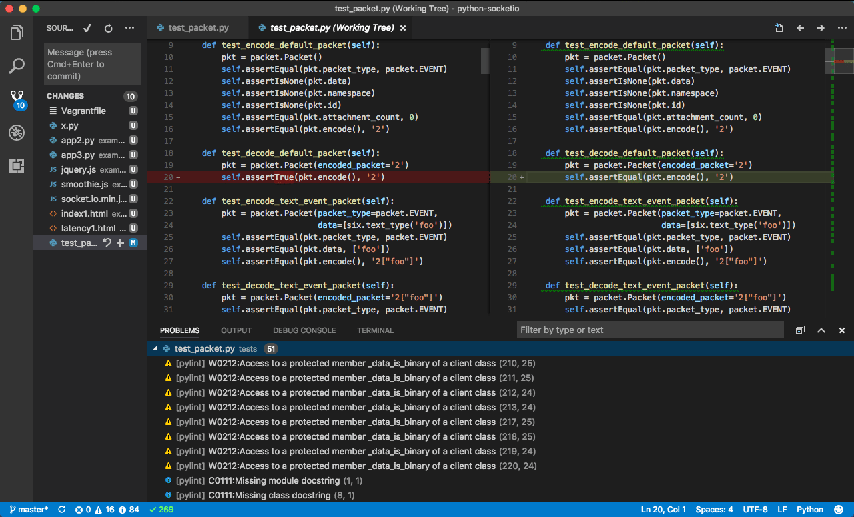

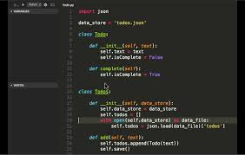

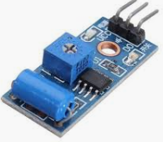
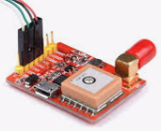
System Layout
DB
CMS
JSONRequest
Raspberry Pi (mounted in a vehicle)
Serial Interface
GPIO/USB
Camera
Collision Detector
GPS module
Joystick

Slide 5
Sensors and GPS Module
Collision Detector
GPS Module
Camera
Joystick

Slide 6
Usage of Sensors and Actuators

Slide 7

Python/PHP Code Snippets (RPi)
. . .
. . .
DB

Slide 8
Kivy Code Snippets (Android)
. . .
. . .

Slide 9
Website Code Snippets (Website)
. . .
. . .

Slide 10
Application
Salient Features of App, Website and RPi

Slide 11
Database
Devices
Log
DID | VN
001 | COL
002 | CAM
003
004
005
006
007
Num | DID | DV | GPS | TS (Time & Date)
001 | 001 | 700, 40, 23, 20, 30, 7 |  | 2018-10-05 03:21:25

Slide 12
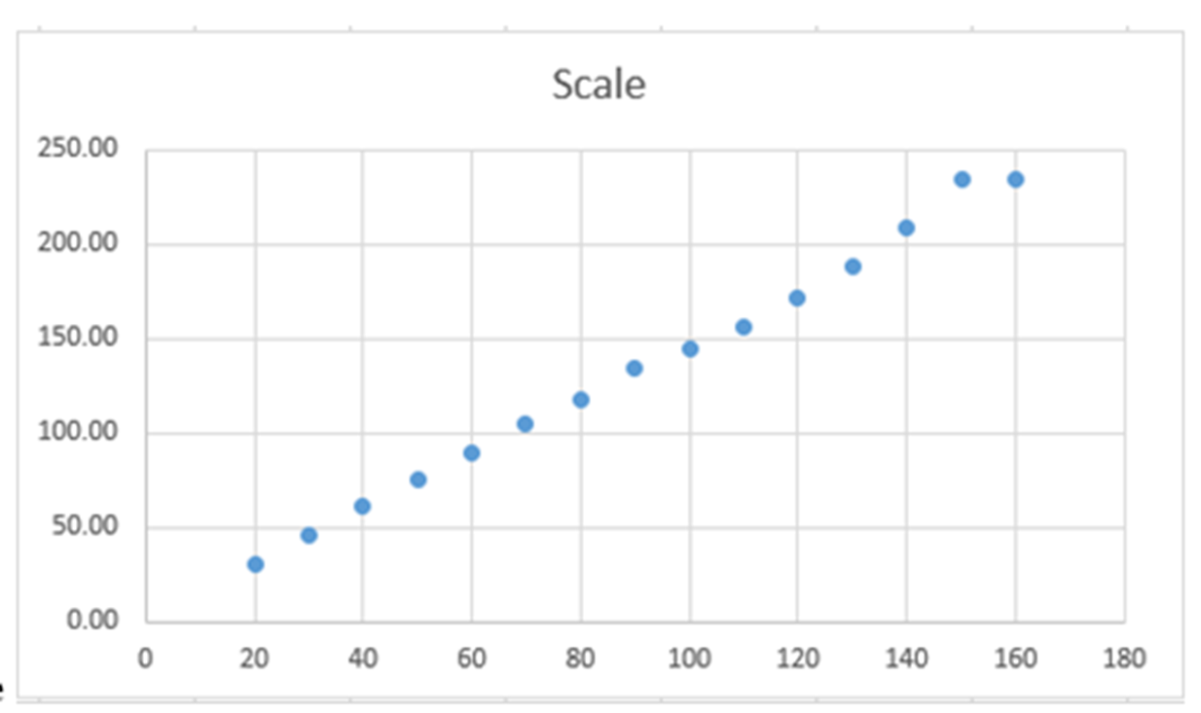
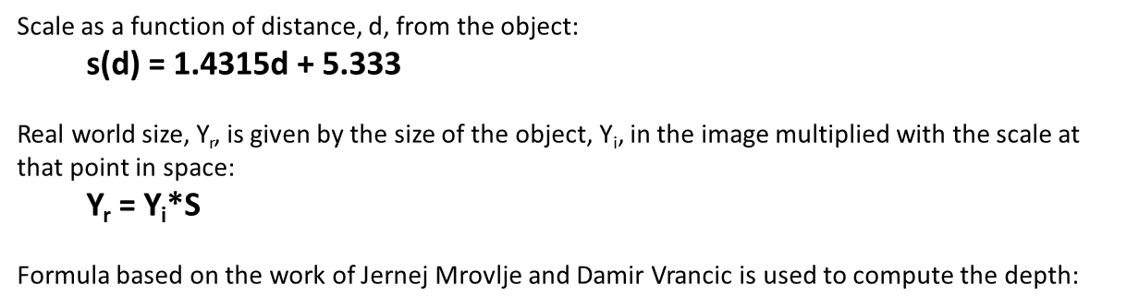
Results and Analysis

Slide 13
Issues and Recommended Enhancements
. . .

Slide 14
Video Demo
. . .

Slide 15
Conclusion
. . .

